Slide 1

LAN-Based Collaborative Whiteboard
Real-time drawing for every device on the network, built on HTTP, TCP and WebSocket
Mini-project presentation
Computer Networks Laboratory (CSE20110)
Department of Computer Engineering and Technology
Vedant Pawaskar – 1262242102 Prajakta Chougule – 1262241465
Yashraj Agale – 1262242073 Bhavya Maisuria – 1262243418
Group 18 Panel k Batch 1,2,3
Faculty: dr. uma pujeri
Academic Year: 2026–2027
Presentation date: [Date]``````````````````
Computer Networks Laboratory CSE20110
15 seconds
Notes:
Suggested time: 15 seconds. Replace all bracketed placeholders and prompts with your own project details. Keep explanations brief. Total time across slides 1–7 is 5 minutes, including the demonstration. Slide 8 is for reference during questions. Logo source: https://mitwpu.edu.in/uploads/images/MIT-WPU-logo-1.webp. Introduce only the title and team; do not read every PRN.

Slide 2
Problem and Objectives
Problem
Teams explain diagrams, topologies and calculations together, but a physical board is not always available and screenshots are never live.
Scope: any browser on a local network becomes one shared canvas, for students and lab teams.
Objectives
1. Build a browser whiteboard shared live by every device on one LAN
2. Use one central server that receives, stores and broadcasts drawing events
3. Use HTTP to deliver the page and WebSocket for live JSON updates
4. Support join, leave and re-join with full state sync
5. Test delivery delay and robustness, and relate results to theory
Computer Networks Laboratory CSE20110
40 seconds
Notes:
Suggested time: 40 seconds. Replace all bracketed placeholders and prompts with your own project details. Keep explanations brief. Total time across slides 1–7 is 5 minutes, including the demonstration. Slide 8 is for reference during questions.

Slide 3
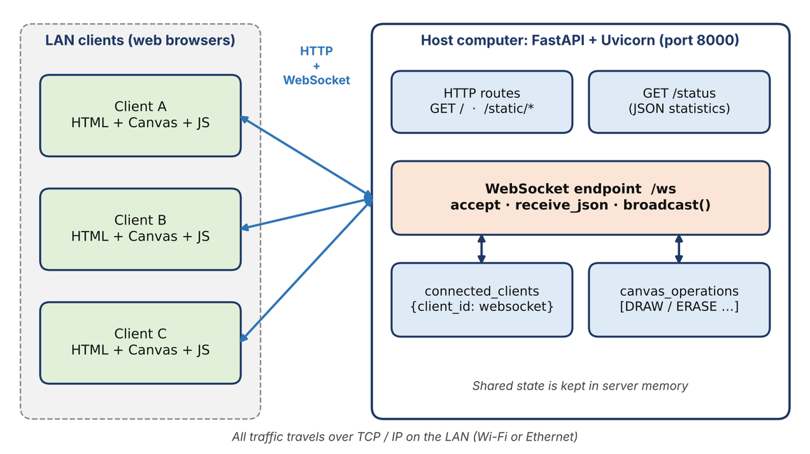
Proposed Design and Tools
PROTOCOL STACK
Application
JSON: DRAW, ERASE, CLEAR, SYNC
HTTP + WebSocket
page, then live /ws
TCP
reliable, ordered, port 8000
IP
LAN address 192.168.x.x
Link
Wi-Fi or Ethernet
Tools: Python, FastAPI and Uvicorn (server); HTML5 Canvas and JavaScript (browser client)
Protocols: HTTP delivers the page; WebSocket over TCP carries live JSON messages [1], [2]
Addressing: server on its LAN IP, port 8000; clients join at ws://host:8000/ws
Computer Networks Laboratory CSE20110
45 seconds
Notes:
Suggested time: 45 seconds. Replace all bracketed placeholders and prompts with your own project details. Keep explanations brief. Total time across slides 1–7 is 5 minutes, including the demonstration. Slide 8 is for reference during questions. Explain the diagram and only the most relevant design decisions. Use an actual project diagram with readable labels.

Slide 4
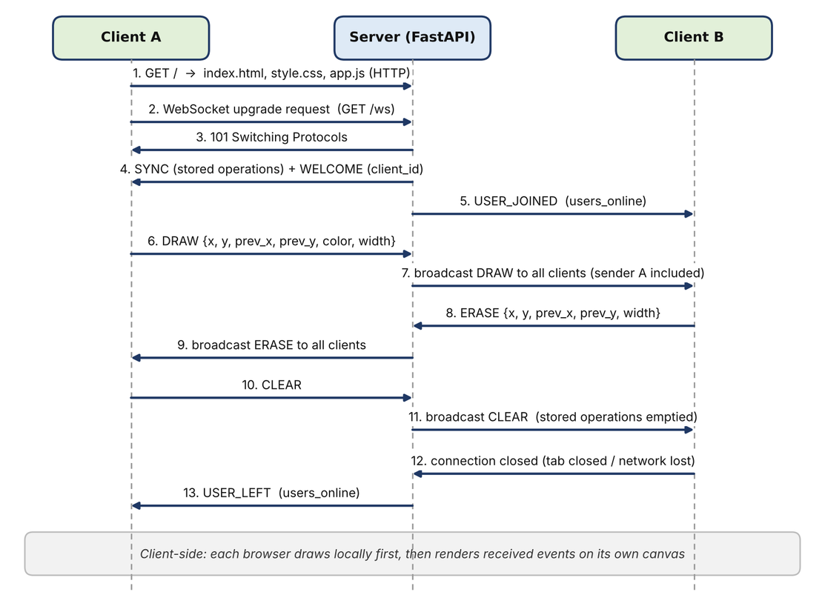
Implementation and Working
BROADCAST LOOP (SIMPLIFIED)
async def broadcast(msg, exclude=None):
for cid, ws in list(clients.items()):
if cid == exclude:
continue
try:
await ws.send_json(msg)
except Exception:
clients.pop(cid, None)
Run: uvicorn main:app --host 0.0.0.0 --port 8000
Message flow: join, draw, leave
Implementation: main.py serves the page, tracks clients, stores strokes and replays SYNC; app.js turns pointer moves into JSON events and renders them
Working: each message is one line segment (current and previous point), so every client redraws it exactly
Troubleshooting: dropped connections are retried by the client every 2 s and the server replays SYNC to restore the board
Computer Networks Laboratory CSE20110
55 seconds
Notes:
Suggested time: 55 seconds. Replace all bracketed placeholders and prompts with your own project details. Keep explanations brief. Total time across slides 1–7 is 5 minutes, including the demonstration. Slide 8 is for reference during questions.

Slide 5
Testing and Results
9 / 9
0.21 ms
500 / 500
12
test cases passed
mean delivery delay
events received, none lost
simultaneous clients
Test: connect, draw, erase, clear, join, leave, restart and load; 200 events timed client to server to client; 500 events sent to 9 receivers; 12 clients at once
Expected: every event reaches every client, in order, with no loss and low delay
Observed: 9/9 passed; 0.21 ms mean delay (PING–PONG 0.17 ms); 500/500 received by each receiver; malformed JSON closed only that client, and a restart gave a new client an empty board
Objectives achieved: 1–4 shown by the working demo and passing tests; 5 by the measurements, taken on loopback, so re-measure on Wi-Fi
Computer Networks Laboratory CSE20110
50 seconds
Notes:
Suggested time: 50 seconds. Replace all bracketed placeholders and prompts with your own project details. Keep explanations brief. Total time across slides 1–7 is 5 minutes, including the demonstration. Slide 8 is for reference during questions. Show actual evidence. Explain the output and mention any failed or partial tests. Do not invent performance figures.

Slide 6
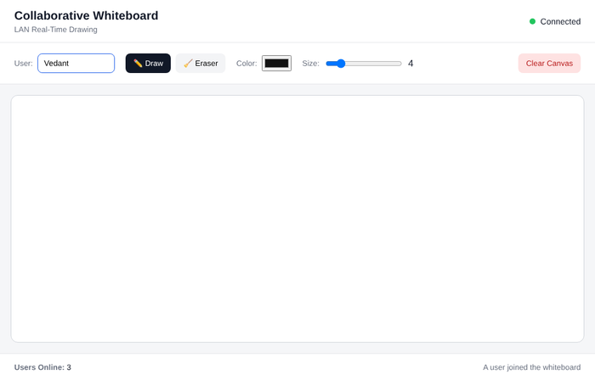
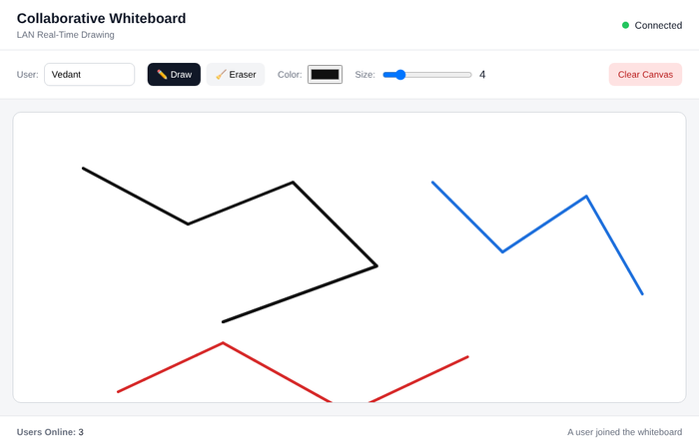
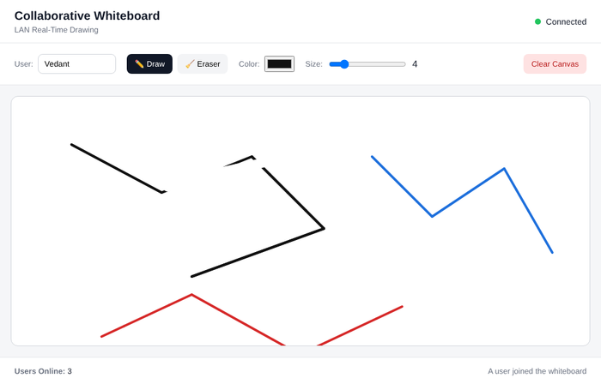
Working Demonstration
Function to demonstrate
Live shared drawing: a stroke, erase or clear on one client appears on all clients
1. Connect: three clients join; every screen shows Users Online: 3
2. Draw: strokes from three users appear on every canvas
3. Erase: an erase by Client B shows up on Client A
Success criterion: every action on any client appears on all other clients at once, and the online count updates
Computer Networks Laboratory CSE20110
65 seconds
Notes:
Suggested time: 65 seconds. Replace all bracketed placeholders and prompts with your own project details. Keep explanations brief. Total time across slides 1–7 is 5 minutes, including the demonstration. Slide 8 is for reference during questions. Prepare the project before the timer starts. Keep the demo to about one minute. Keep a screenshot or short recording ready as a backup, and identify it as recorded evidence if used.

Slide 7
Conclusion and Contributions
Outcome: a working whiteboard where a browser loads the page over HTTP, upgrades to WebSocket on TCP, and exchanges small JSON messages with one FastAPI server
Application: shared diagrams, topologies and calculations for classrooms and lab teams on one LAN
Limitation: no login or encryption (trusted LAN only); drawing is kept in memory and lost on restart; one server
Future scope: rooms with access codes, persistent storage, undo/redo, and tests on Wi-Fi with Wireshark
Team contributions
Vedant Pawaskar – Backend
Prajakta Chougule –UI
Yashraj Agale – Logic
Bhavya Maisuria – documentation
Computer Networks Laboratory CSE20110
30 seconds
Notes:
Suggested time: 30 seconds. Replace all bracketed placeholders and prompts with your own project details. Keep explanations brief. Total time across slides 1–7 is 5 minutes, including the demonstration. Slide 8 is for reference during questions.

Slide 8
References
[1] I. Fette and A. Melnikov, "The WebSocket Protocol," RFC 6455, IETF, Dec. 2011. [Online]. Available: https://www.rfc-editor.org/rfc/rfc6455
[2] R. Fielding, M. Nottingham and J. Reschke, "HTTP Semantics," RFC 9110, IETF, Jun. 2022. [Online]. Available: https://www.rfc-editor.org/rfc/rfc9110
[3] W. Eddy, Ed., "Transmission Control Protocol (TCP)," RFC 9293, IETF, Aug. 2022. [Online]. Available: https://www.rfc-editor.org/rfc/rfc9293
[4] FastAPI, "WebSockets," FastAPI documentation. [Online]. Available: https://fastapi.tiangolo.com/advanced/websockets/
[5] Uvicorn, "Uvicorn: An ASGI web server for Python." [Online]. Available: https://www.uvicorn.org/
Computer Networks Laboratory CSE20110
Backup slide
Notes:
Suggested time: Backup slide. Replace all bracketed placeholders and prompts with your own project details. Keep explanations brief. Total time across slides 1–7 is 5 minutes, including the demonstration. Slide 8 is for reference during questions.

